Slide 1
25/07/2023
DevOps–Sample Case

Slide 2
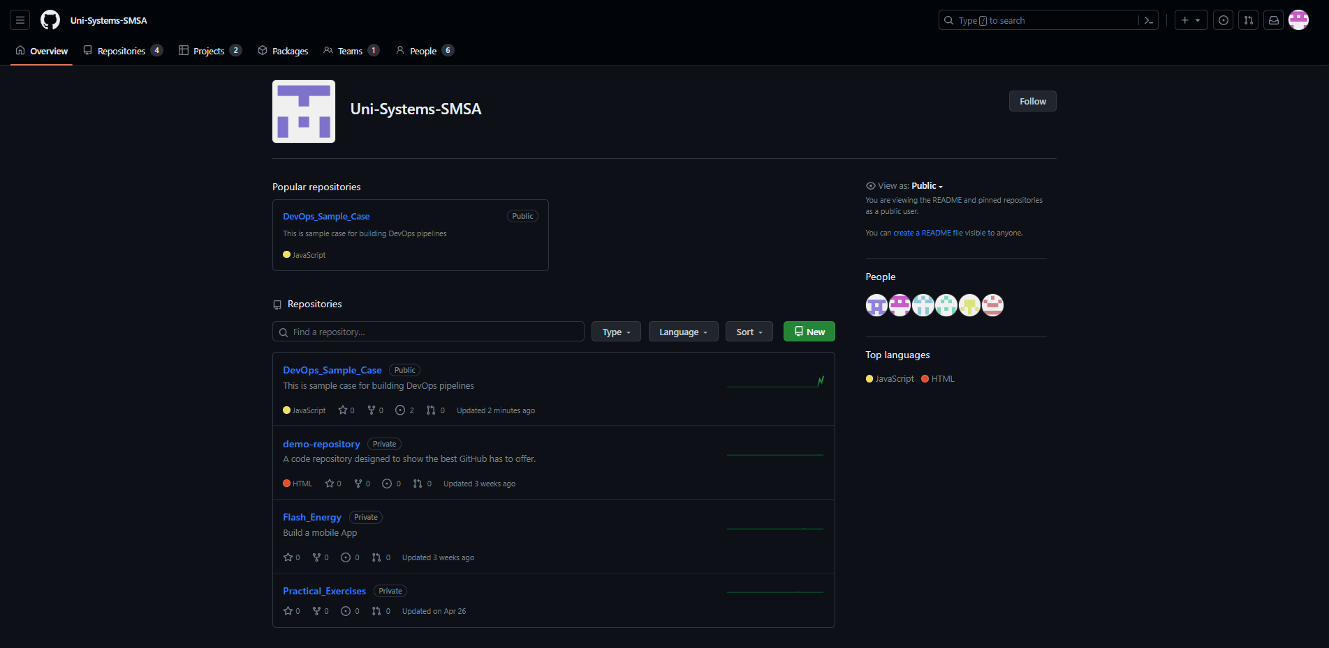
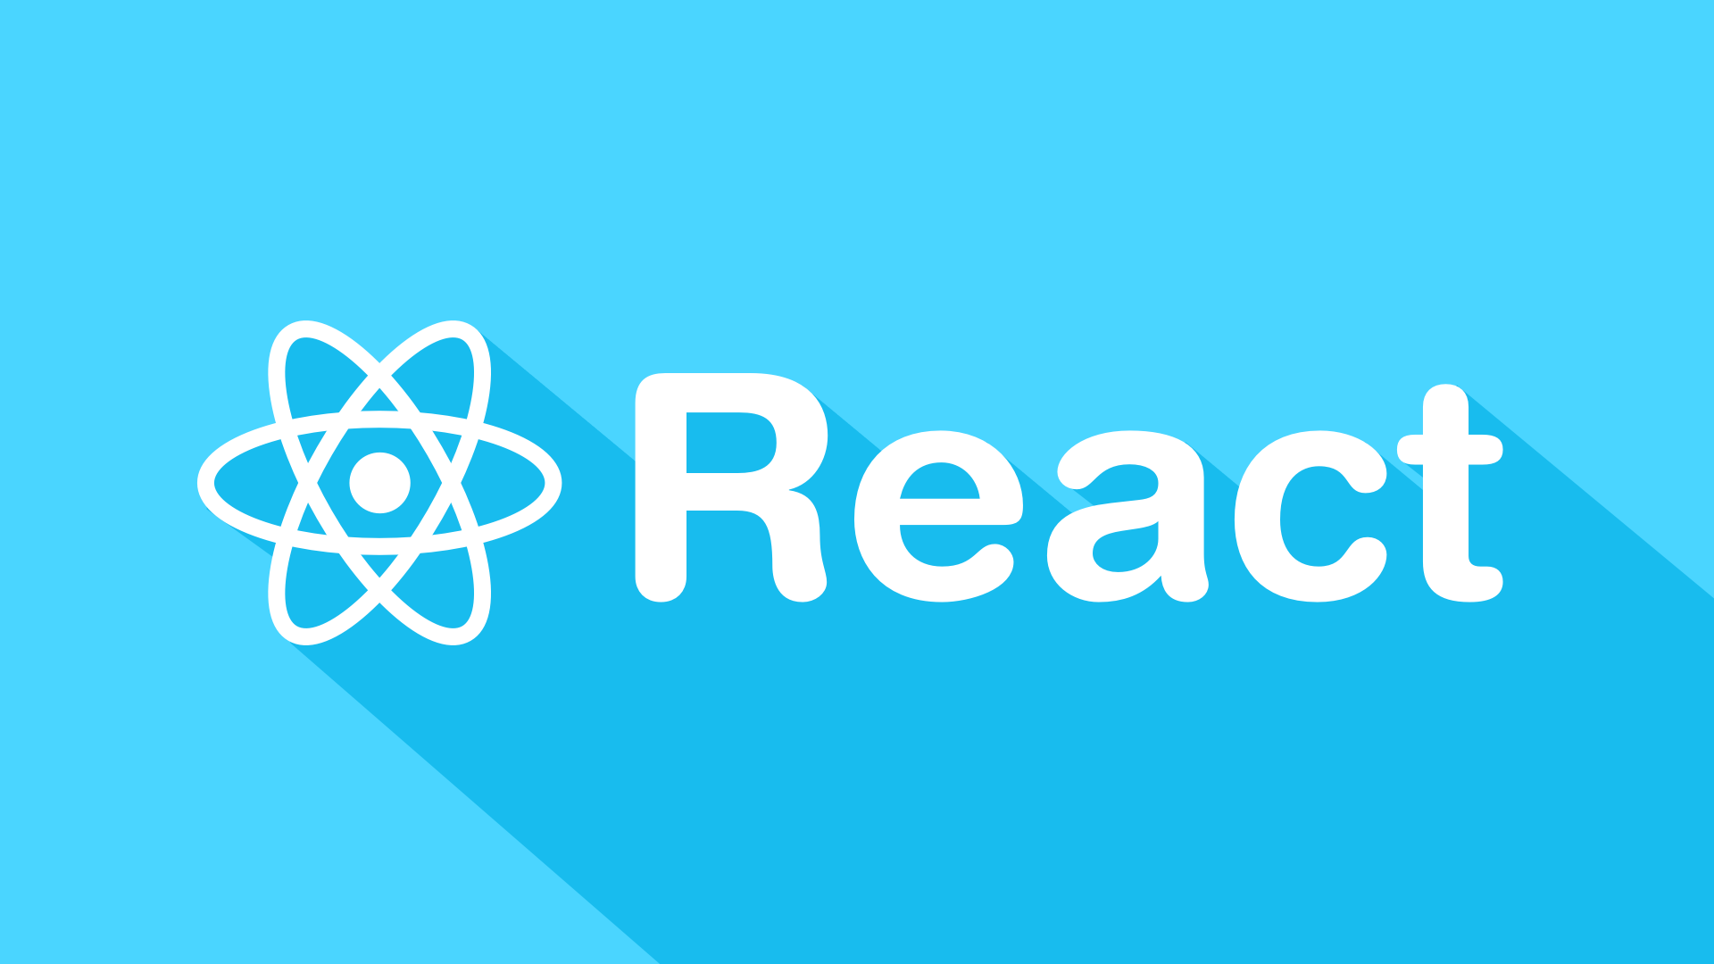
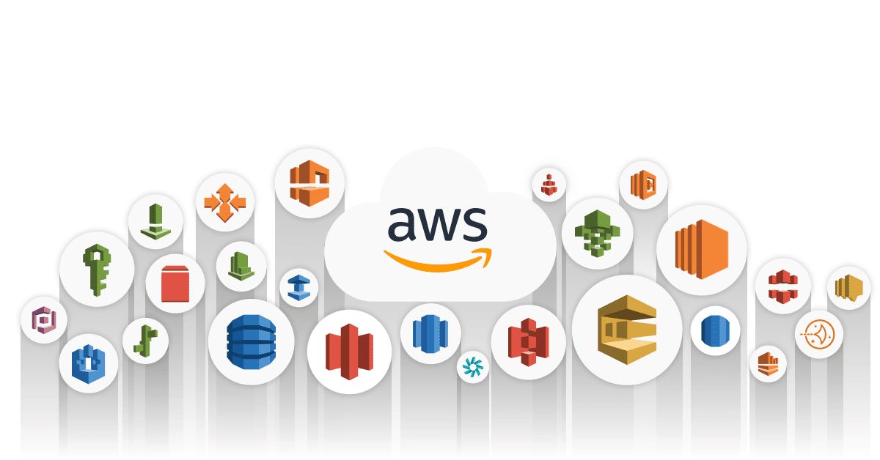
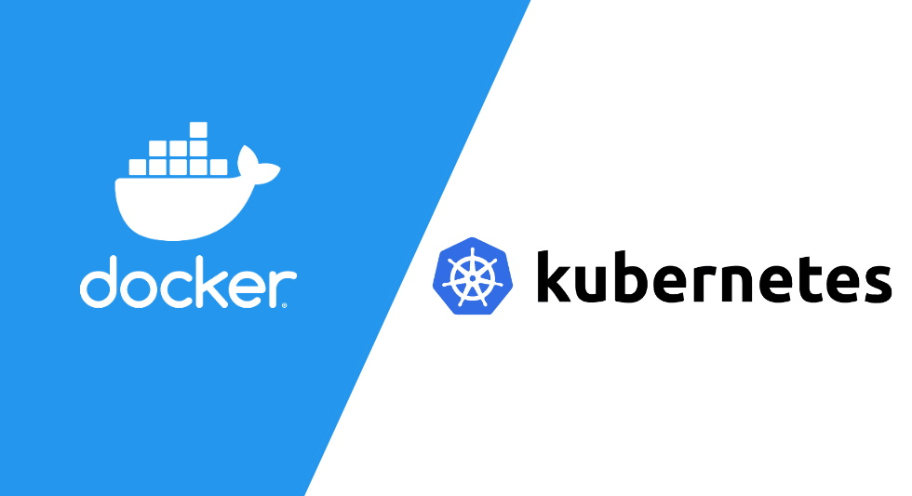
DevOps-Tools (based on GitHub Components)
GitHub - Organization
React - React Testing Library
AWS
Docker - Kubernetes
Used to manage teams, repositories and projects.
Enables many developers to work simultaneously
Open source JavaScript library for creating User Interfaces
Has a dedicated testing library for testing the code
More than 200 services to build and deploy on the cloud
Free Tier program with many possibilities
Seamless communication between the services
Easy way to run applications using a microservices architecture without depending on the OS
Manage microservices
Deploy using config files using only a few commands

Slide 3
DevOps – Sample Case
ST: 07/2023 – ET :09/2023 Modality - 01: Modality - 02:
Modality - 03:
Beneficiary : RDI & Business Development Unit
Role: DevOps
User Stories : As a DevOps I want to ….. So that
Criteria :
Specified DevOps Responsible
Created a GitHub Account (Organization: Uni-Systems-SMSA, Organization Roles, Internship Team & Repositories (free with constraints – No enterprise edition ))
Created Project (React Login & Dashboard pages with Authorization) & Issues (Dashboard)
Created a Docker Hub Account ( Docker Hub – for the organization – Internship Team )
Created Free Tier Cloud Account WS (link with Internship Team
Built a CI/CD pipeline
Present Your Project (Join Communities, Register to several Slack communities)
Start Contributing to Open-Source ( AWS open source STF/Fiware)

Slide 4
DevOps Responsibilities (Organization)
Specify Roles of the Project (Team Leader, Developers,…)
Specify working environment (GitHub/Gitlab/…)
Specify rules and steps for the development process (Branch protection rules)
Specify the packaging of the code
Specify the release of the code (delivery)
Specify the deployment of the code (deployment)

Slide 5
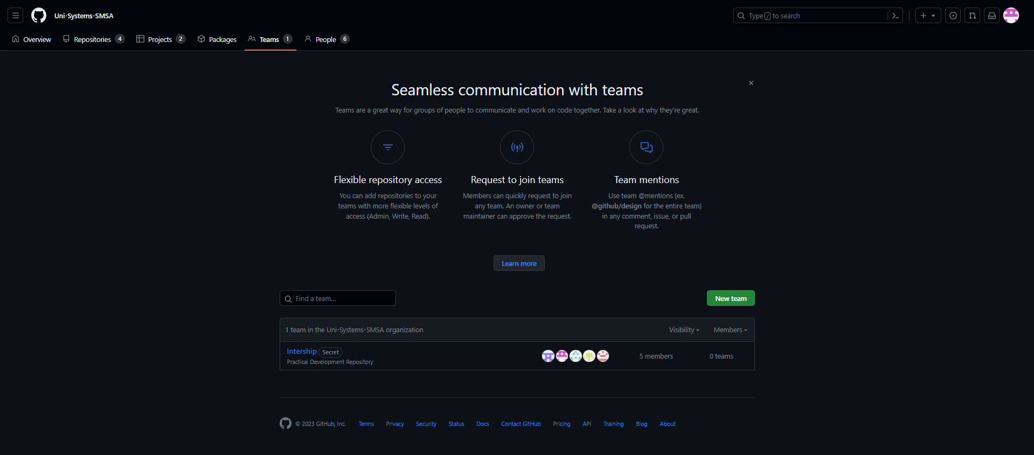
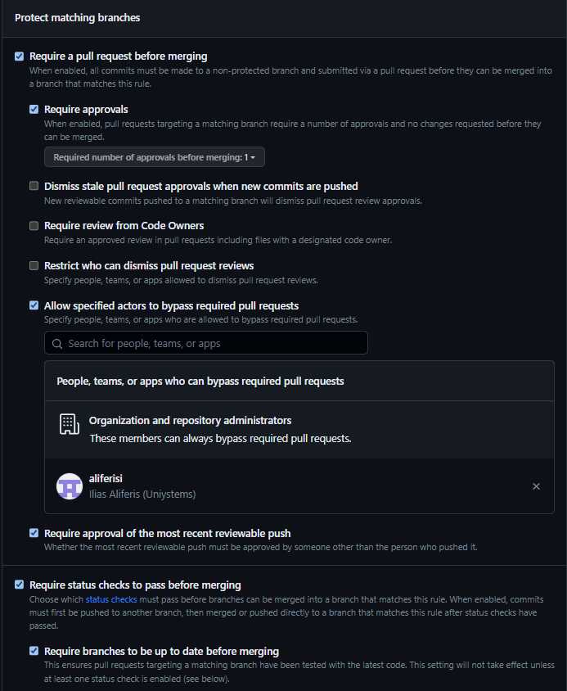
GitHub
GitHub can be used to manage a whole organization with different teams and projects.
Every member has a unique account and is part of the Organization
The organization has multiple repositories one (or more) for each project
With GitHub multiple members can work simultaneously without interfering with each other
Also we can set rules to ensure the development phase goes smoothly
More information can be found on this GitHub repository which is a sample case for our project

Slide 6
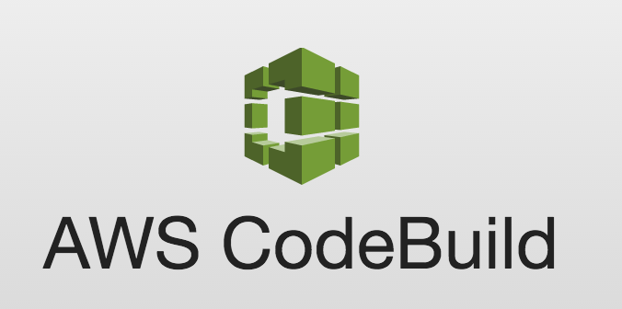
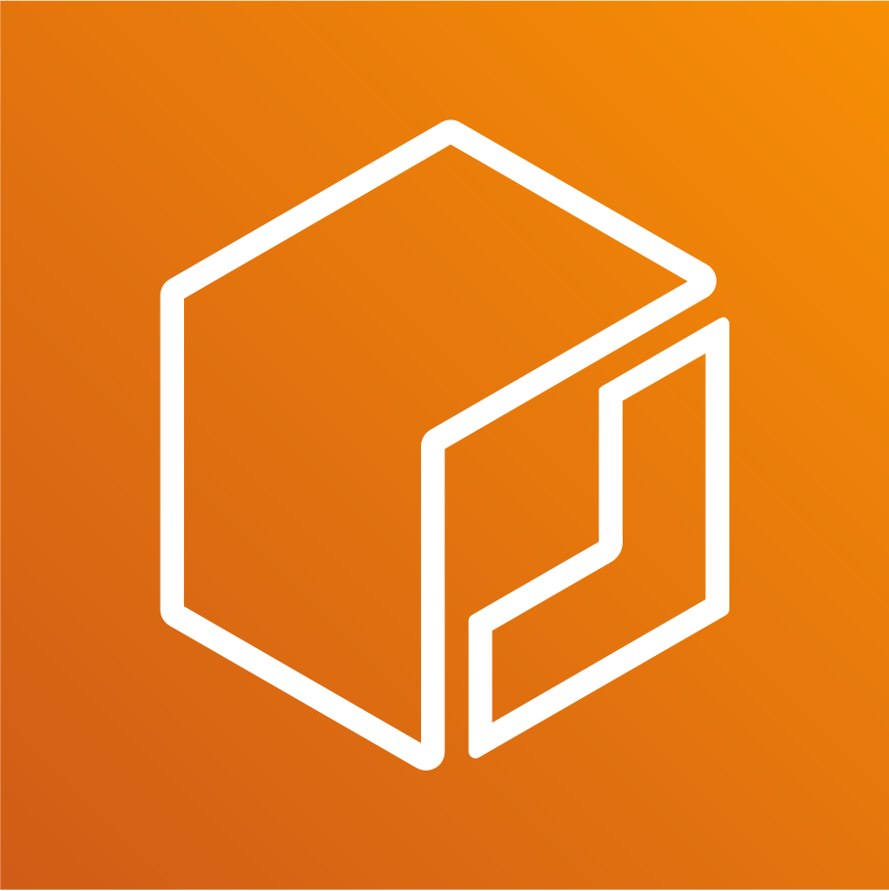
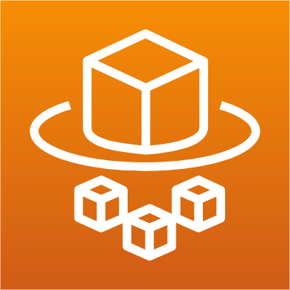
AWS
AWS has a vast variety of services we can use for our projects.
CodeBuild ( take the code and run a set of commands to make an executable (.exe, Docker image, …)
Elastic Container Registry (create private or public registries to store Docker Images)
Fargate (a service to host a docker application on the cloud without needing to manage the servers)

Slide 7
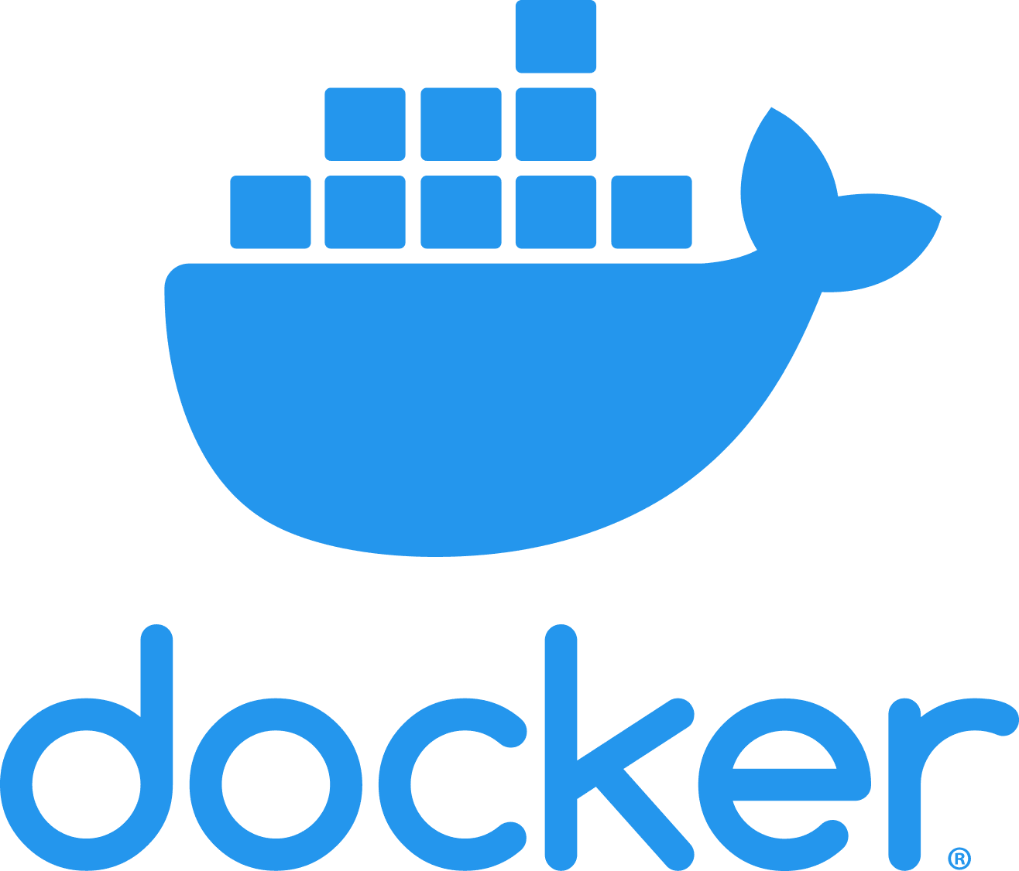
Docker
Docker is a software platform that allows you to build, test, and deploy applications quickly.
Docker packages software into standardized units called containers that have everything the software needs to run including libraries, system tools, code, and runtime.
The biggest advantage of using Docker is that you can quickly deploy and scale applications into any environment and know your code will run.

Slide 8
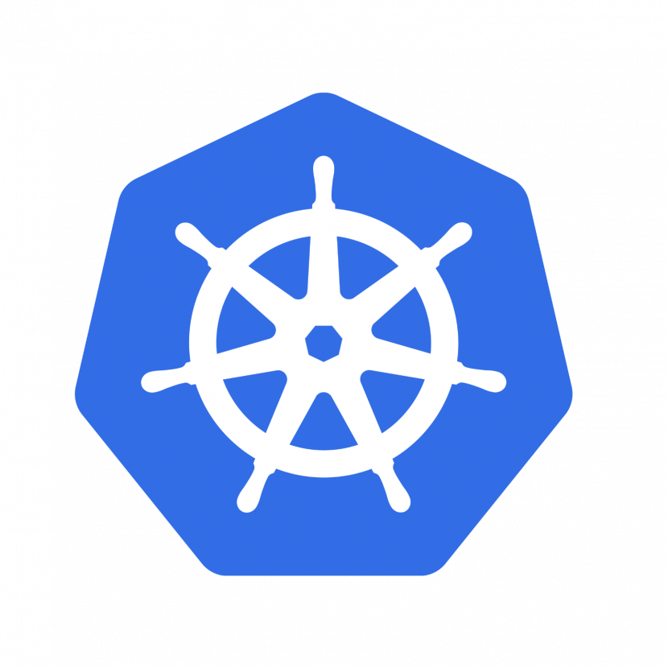
Kubernetes
Kubernetes is an open-source system for automating deployment, scaling, and management of containerized applications.
Kubernetes is used to manage clusters which consists of nodes (VMs) and each node runs pods (containers) of Docker Images
A Kubernetes cluster can be on-premises, hosted on the cloud or a hybrid between the two

Slide 9
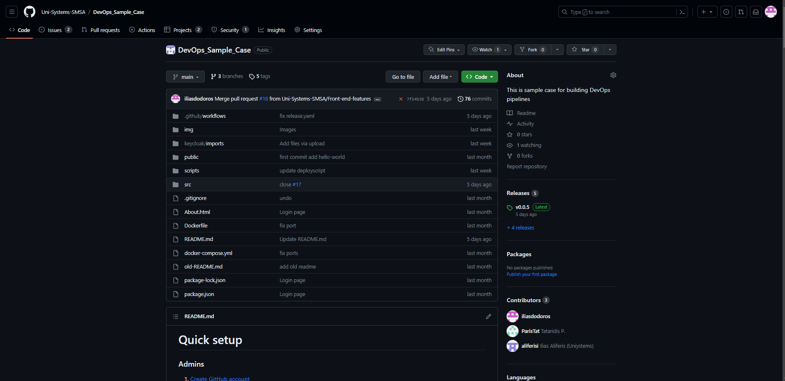
GitHub Sample Case - Admin
Create GitHub Account (here)(Pro Vs Enterprise (limitation of Pro)
Create organization Uni-Systems-SMSA Organization (one time)
Create team (Teams · Uni-Systems-SMSA)
Invite members Intership · Uni-Systems-SMSA Team (Add a member)
Create a GitHub repository and assign a team to have write permissions Uni-Systems-SMSA (New repository)
Add Team (Internship) or single member (Manage access) and Define roles/permission on the repository (project approach)
Define development branches (front-end & back-end)
Define Branch protection rules (image)
Create GitHub actions to automate build and test steps of the pipeline (examples here)

Slide 10
GitHub Sample Case - Member
Create GitHub Account (here)(option – Free , Pro, Enterprise – Pos , Cons)
Join Uni-Systems-SMSA Organization through invite from owner
Join the Internship team inside the organization from the invite that was sent
Create a new branch to start working on the project
When your task is finished you can create a pull request so that your work is integrated in the main branch.
Details on the steps can be found here.

Slide 11
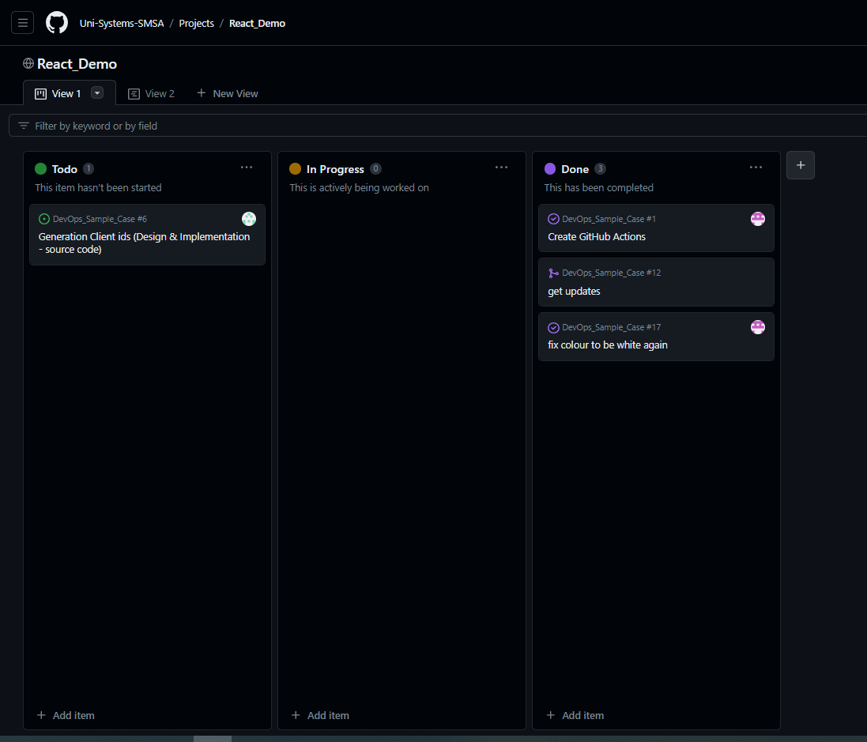
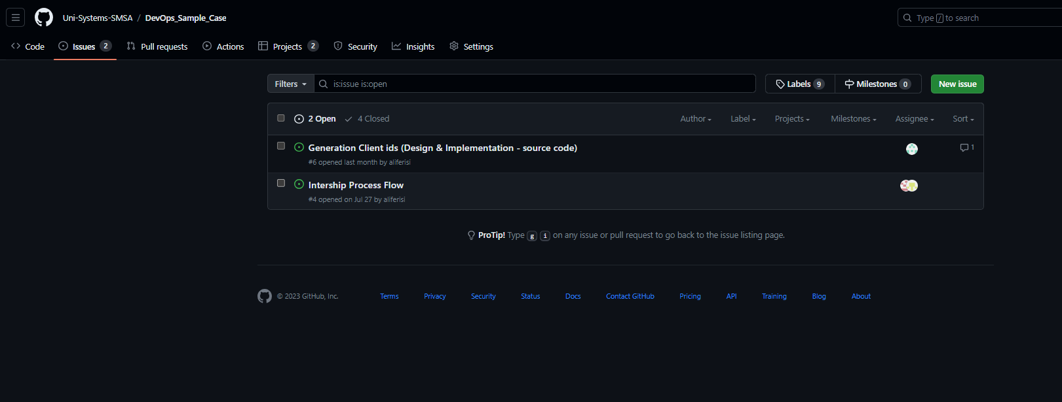
Task Management – GitHub Issues – GitHub Projects
GitHub offers a task management tool called GitHub Project which has an integration with GitHub Issues
Issues can be created from here and can be assigned to one or more persons
Projects provide a very useful and easy to use interface to organize issues and tasks

Slide 12
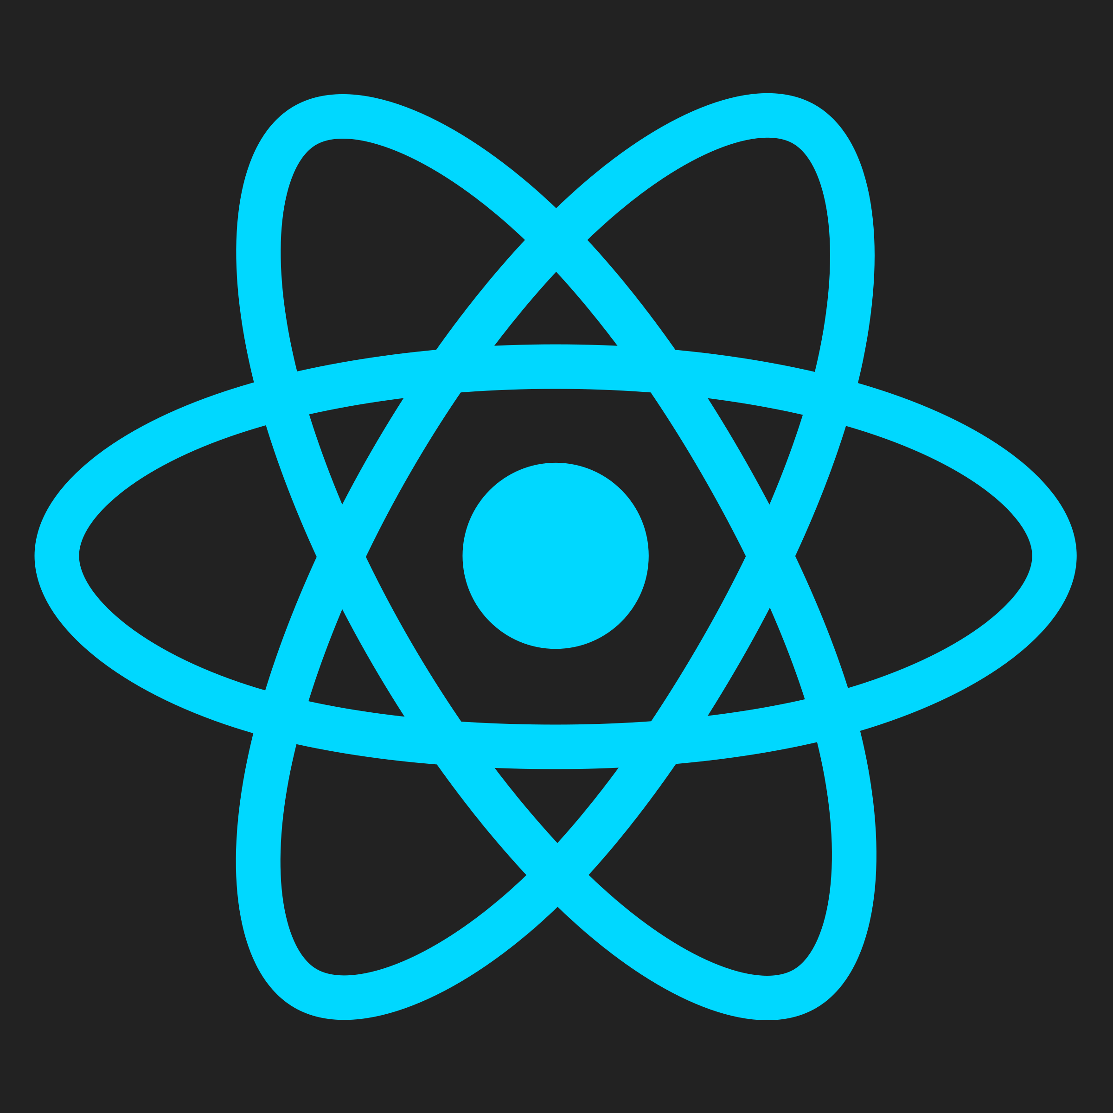
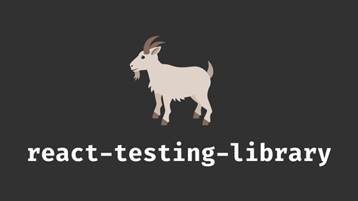
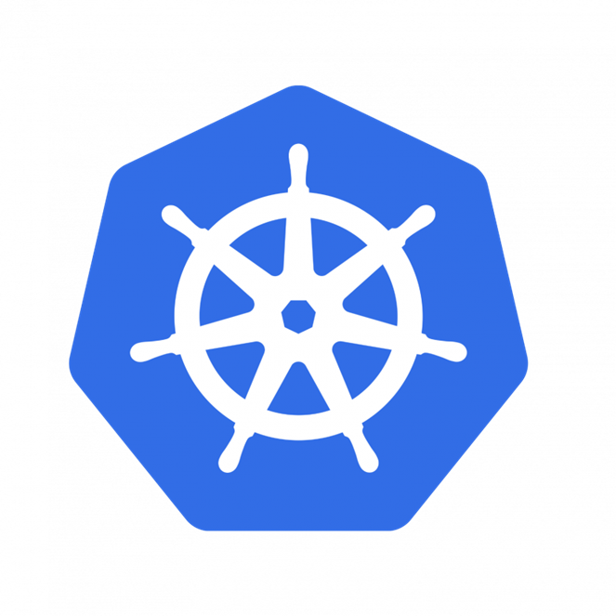
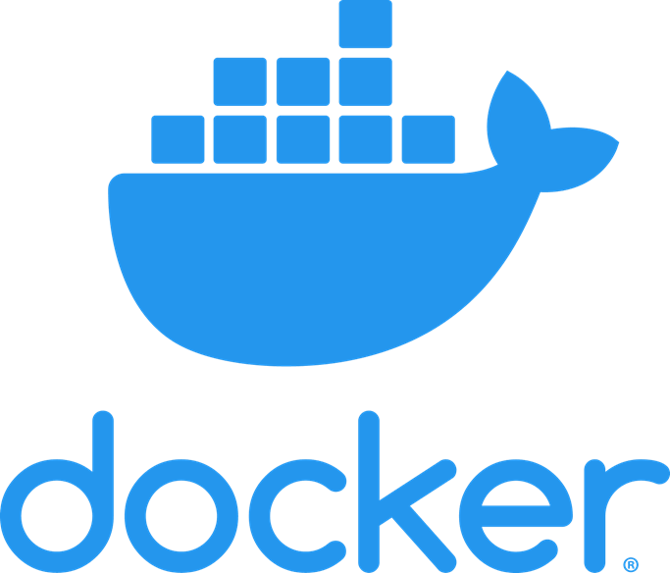
Define Simple CI/CD Pipeline
The pipeline we created are composed of the following steps:
Build
Test
Package
Deploy

Slide 13
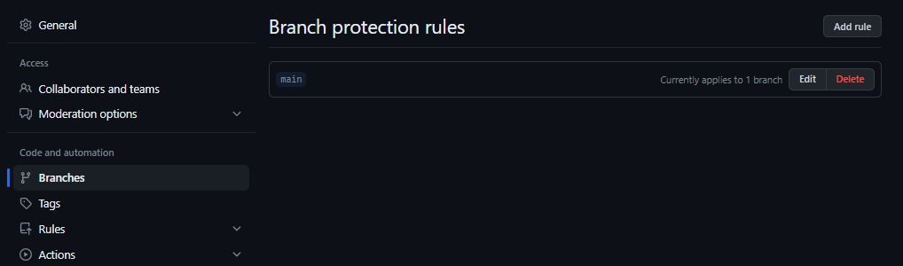
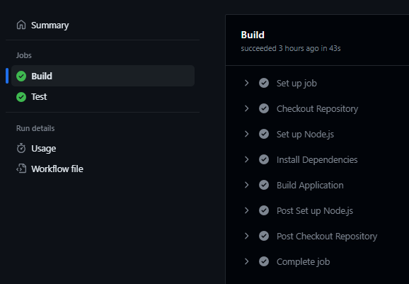
Build Step – GitHub Action
The build step is made up from the development of the project (code).
For the build step we set branch protection rules to protect the main branch (see the list here)
The GitHub Action config file can be found here

Slide 14
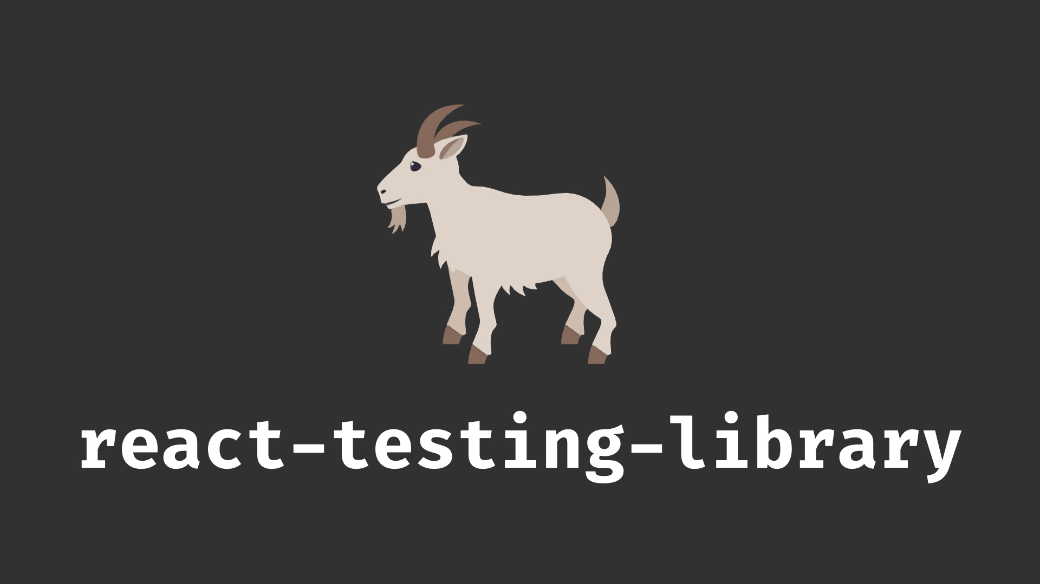
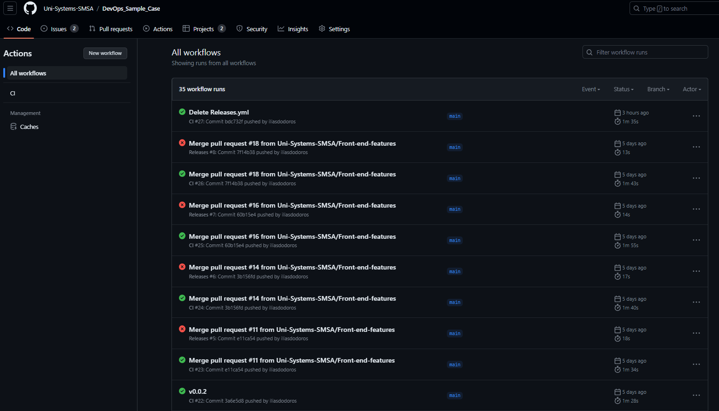
Test Step - GitHub Action
The testing of our code is done with React Testing Library (alternative : Jest)
We set a Unit Test in our code as an example (code here)
Every push to main must pass this Test to be accepted

Slide 15

Packaging Step – Shell script (VM 224)
The packaging step is done on our server every time we want (alternative AWS CodeBuild)
First we set up the Docker Engine on our VM (tutorial)
Then we created a docker registry on our VM to store our Docker Images (tutorial)
We created our Dockerfile to specify the commands the Docker engine executes to create a Docker image from our code
Then we wrote the script that we run when we want to package a new version of our code
If we want to use the new version of our code we can find it in our registry

Slide 16
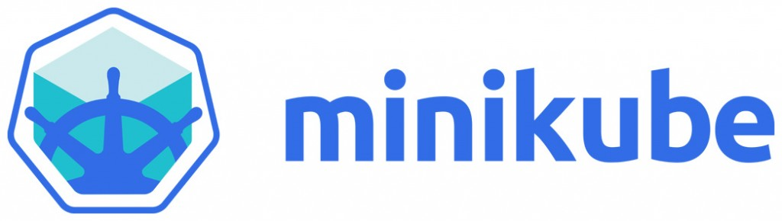
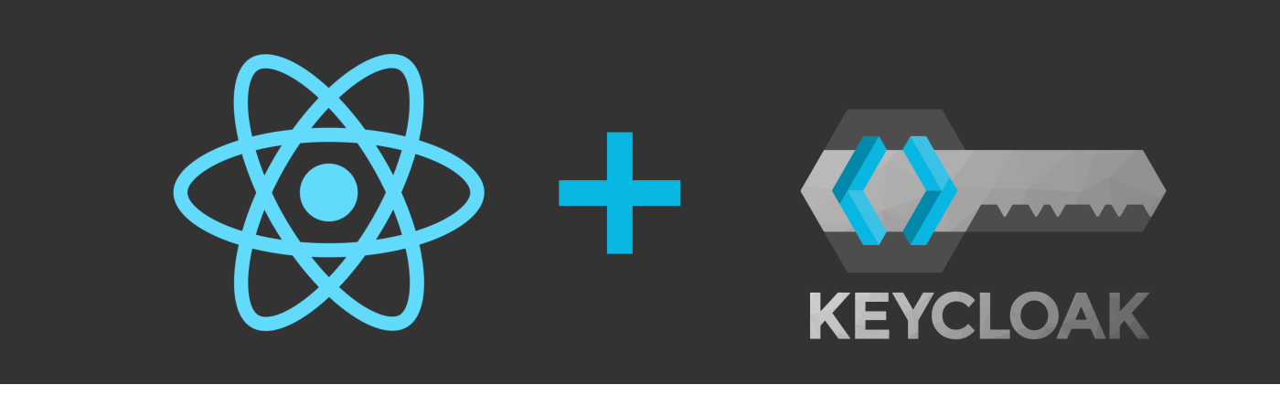
Deployment Step – Kubernetes / Minikube
Minikube is an application that creates a Virtual cluster inside of a Docker container.
In this virtual cluster we deployed two Pods for our React app and two for Keycloak
We also created a load balancer for our frontend application which automatically directs request to the least busy pod

Slide 17
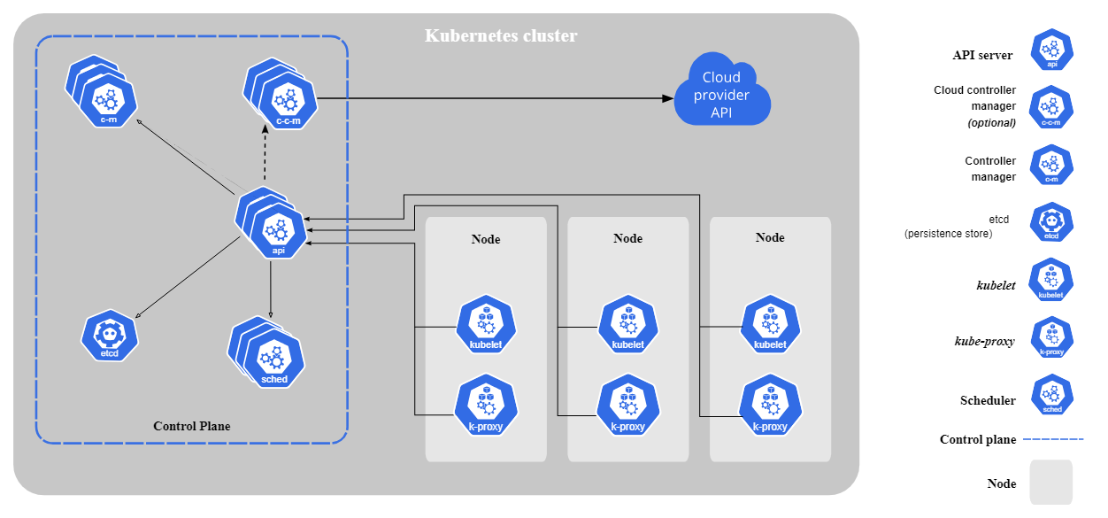
Future Goals
Create a Cluster with multiple Nodes (VMS) and deploy application there open to traffic (production environment
Improve Kubernetes knowledge and configuration
Create a fully automated CI/CD pipeline

